Slide 1
A. After a short period of détente in the early 1970s, tensions reignited with the ‘Axe Murder Incident’ in 1976, which raised the prospect of a renewal in armed conflict. North Korean soldiers attacked an American work party trying to chop down a tree inside the demilitarised zone between North and South Korea. Two US army officers were killed. Readiness levels for American forces in Korea were raised to DEFCON 3 and rocket attacks were considered. However, the South Korean president did not push for military action.
B. Kim Il Sung maintained power from 1953 to 1994, when he passed away as a result of a stroke. He used a mix of propaganda, terror and ideology to maintain control over North Korea throughout the period.
C. An attempt to kill South Korean President Chun Doo Hwan took place when North Korea planted a bomb in a mausoleum in Yangon, Myanmar during a visit by Chun. He survived but 21 people, including some government ministers, were killed. On 29 November 1987, a bomb planted on a Korean Air flight exploded over the Andaman Sea, killing all 115 people on board. Seoul accused Pyongyang, which denied involvement.
D. Syngman Rhee was forced from power in South Korea. After rigged elections were held, student protestors successfully pushed for the resignation of Rhee. For a year, a fragile democratic government admistered the country. A military coup led by General Park Chung Hee was carried out in 1961, with the resultant termination of the infant democracy.
E. President Park was assassinated by his intelligence chief after an argument in 1979. A military coup directed by Chun Doo-Hwan was opposed by protestors in the city of Gwangju in May 1980. Student demonstrators, labelled as ‘communist sympathisers’, were brutally put down, with around 160 killed. The uprising failed but served to inspire pro-democracy movements in the latter part of the decade.
F. Pro-democracy movements in South Korea swept the country. Free elections were held in 1987. The USSR collapsed. Kim Il Sung was deprived of resources and support, to the extent that it contributed towards the development of the famine in the mid- to late-1990s. However, Kim continued to maintain firm control over North Korea and started to accelerate moves towards a nuclear weapons capability.
G. South Korea became involved in the Vietnam War. President Park sent troops in 1964 to support the US intervention. 300,000 South Korean soldiers served in the war until their withdrawal in 1973. South Korea’s decision to join resulted from various underlying causes, including the development of US–ROK relations, political benefits and the promise of economic aid from the United States. North Korea also sought to give aid and assistance to North Vietnam.
H. Both countries carried out a continuous propaganda campaign throughout the period. Propaganda in the North was (and still is) used to promote the cult of the leader, anti-Americanism and ‘anti imperialism’, as well as emphasise ‘Juche’ – self-reliance. A ban on films and music, as well as media censorship, was in place on both sides of the Peninsula.
I. North Korea attempted an assassination on South Korean President Park. On 21 January 1968, a team of 31 North Korean commandos was sent to Seoul to assassinate President Park Chung Hee but was intercepted by South Korean security forces. All but two were killed. The North also captured a US patrol boat, the US Pueblo. South Korea planned an attempted incursion and assassination mission against Kim Il Sung. It was cancelled after diplomatic relations improved.
Resource sheet 7.3A

Slide 2
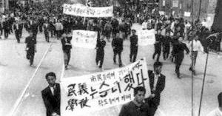
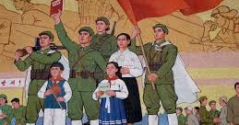
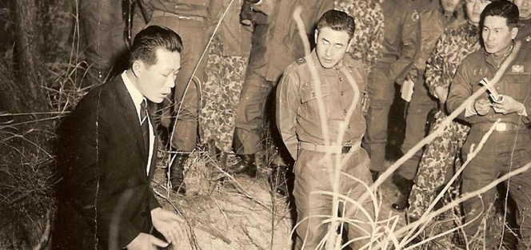
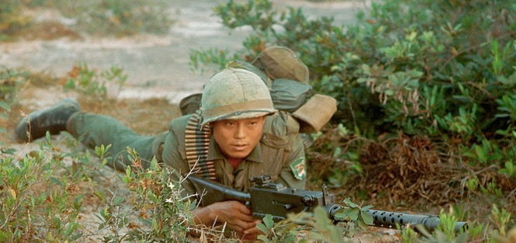
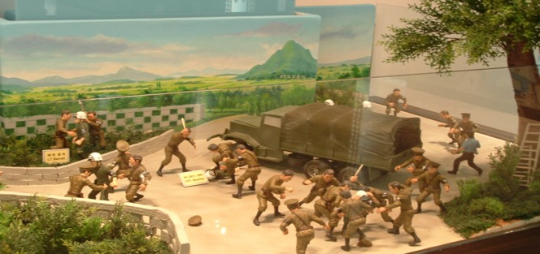
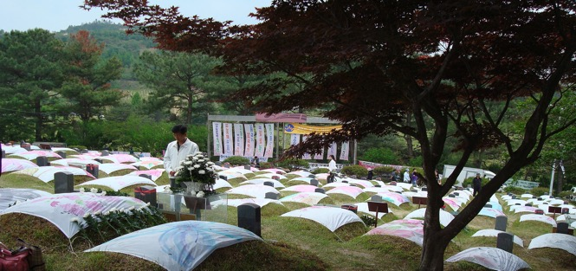
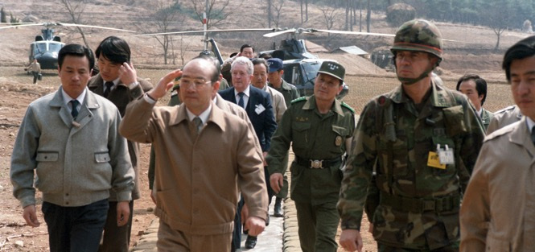
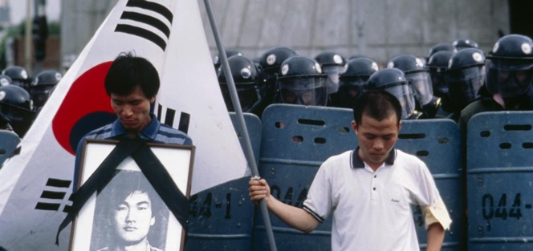
© Kim Newton All Rights Reserved
Resource sheet 7.3A
Notes:
Image credits, from top left:
April Revolution: Kyunghyang Shinmun, http://news.khan.co.kr/kh_news/khan_art_view.html?artid=200808181834035&code=210000
North Korean propaganda image: CC BY 2.0/Mark Fahey from Sydney, Australia/Wikimedia, https://commons.wikimedia.org/wiki/File:North_Korean_propaganda_(1).jpg
Kim Il Sung image: CC BY-SA 3.0/Gilad Rom/Wikimedia, https://commons.wikimedia.org/wiki/File:Kim_Il_Sung_Portrait-2.jpg
General Han Moo-hyup with Kim Shin-jo: CC BY-SA 3.0/Relamian/Wikimedia, https://commons.wikimedia.org/w/index.php?curid=25643922
South Korean soldiers in Vietnam: CC BY 2.0/Phillip Kemp/Wikimedia, https://commons.wikimedia.org/wiki/File:Photo_taken_by_Phillip_Kemp_from_cockpit_after_sling-loading_water_drums_to_outpost..jpg
© Author/Guy Birks, taken at the Joint Security Area, Panmunjeom, South Korea, 2012
Mangwol-dong cemetery: CC BY-SA 3.0/Rhythm/Wikimedia, https://commons.wikimedia.org/w/index.php?curid=4089746
Chun Doo-hwan and Claude M. Kicklighter, US Department of Defense, https://commons.wikimedia.org/w/index.php?curid=16569008
© Kim Newton All Rights Reserved; https://global.arizona.edu/sites/default/files/Newton_Seoul_1987_0.jpg; see article https://global.arizona.edu/news/ua-journalist-delivers-historic-photo-south-korean-leader

