Slide 1
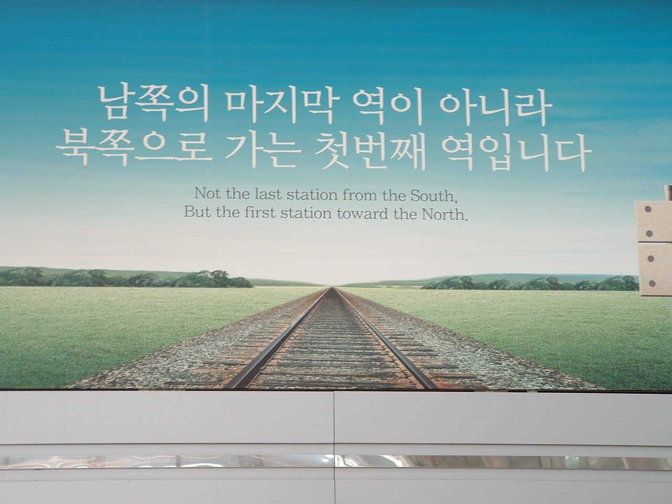
Enquiry 7:
An unfinished war
Why was there no peace in Korea?
Notes:
Image: © Author/Guy Birks

Slide 2
Enquiry 7 overview:
An unfinished war. Why was there no peace in Korea?
Lesson 7.1
Why did the Korean War drag on until 1953?
Lesson 7.2
How did the war leave an enduring impact on the Korean
people?
Lesson 7.3
Could a ‘hot war’ have erupted again in Korea during the Cold War?
Lesson 7.4
Why has there not been peace in Korea even after the end
of the Cold War?

Slide 3
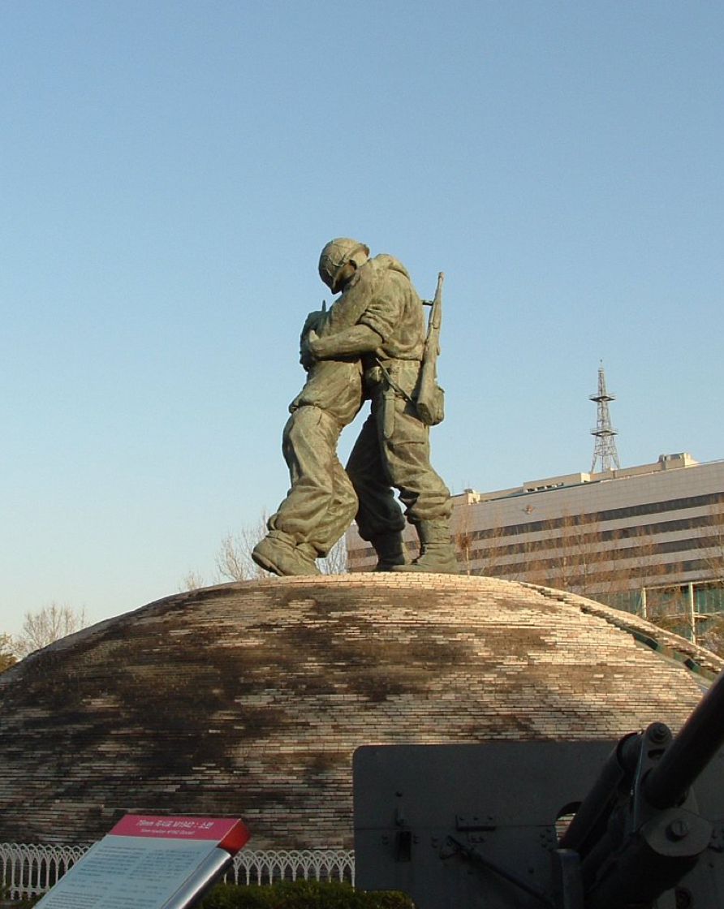
Lesson 7.1: Why did the Korean War drag on until 1953?
Starter
The statue on the right is called ‘The Statue of Brothers’. It is in Seoul, South Korea.
Who do you think the figures at the top represent?
What do you think the dome they are standing on represents?
What impression of the war does this give you?
What do you think is this statue’s main message?
Notes:
Image: © Author/Guy Birks. To see this in context at the National War Memorial visit www.warmemo.or.kr/LNG/visitorsGuide/map.do

Slide 4
Lesson 7.1 Overview and aims
Lesson 7.1
Why did the Korean War drag on until 1953?
In this lesson you will:
Analyse and evaluate historians’ interpretations as to why the Korean War dragged on until 1953.
Critically assess primary sources related to the various factors that helped to prolong the war.
Reach a judgement as to what was the main reason for the continuation of the war.

Slide 5
How the war of movement turned into a stalemate
For a period of a year, the frontline in Korea moved dramatically. The initial invasion of the North pushed UN and South Korean forces to the Pusan Perimeter. After MacArthur’s landing of troops at Incheon and the UN advance northward, the front was pushed up towards the Chinese border.
The subsequent Chinese intervention pushed the frontline back into South Korea. UN forces regrouped and pushed Chinese and North Korean forces back to an area around the 38th parallel. In the period of a year, Seoul, the capital of South Korea, changed hands four times.
However, by April 1951, the war had become bogged down into a stalemate, with skirmishes and battles fought over mountains and passes that were claimed, lost, then reclaimed by both sides.
There was no sign of a decisive breakthrough on either side.
Yet this war dragged on for another two years.
Why, therefore, did peace talks drag on for two years?
Notes:
Images: CC BY-SA 3.0/Roke/Wikimedia, https://commons.wikimedia.org/wiki/File:Korean_war_1950-1953.gif

Slide 6
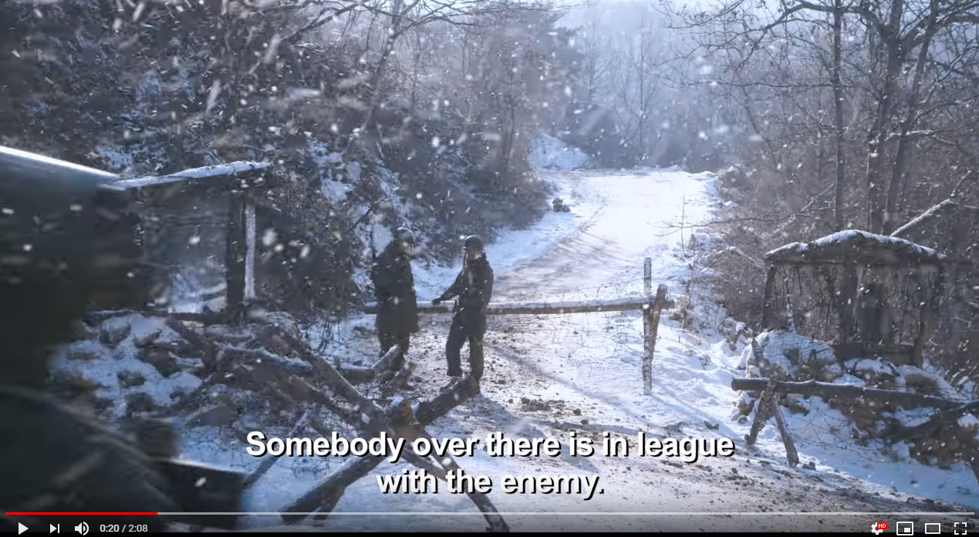
How the war of movement turned into a stalemate
Activity 1
What does the film trailer reveal about the nature of the Korean War after 1951?
This is a trailer for a Korean movie made in 2011 called The Frontline.
Notes:
Video: www.youtube.com/watch?v=HDB9qr63GBE

Slide 7
Why did the Korean War not end in 1951?
Activity 2
Complete column 2 of this table using the interpretations on slides 8–11.
Historian | Activity 2 Main views of the interpretation | Extension How can the view be supported? | Extension How can the view be challenged?
A. Kathryn Weathersby
B. Bruce Cumings
C. Rosemary Foot
D. Philip Towle
Extension: Undertake your own research into the work of each historian and complete columns 3 and 4. Use analysis of historiography and supporting information from sources. Is the Korean War their specialist subject? Do they have a particular viewpoint that shapes their analysis?

Slide 8
Historian A: Katharine Weathersby… on why the war did not end in 1951
‘Once China entered the Korean War in October 1950 and saved the DPRK from extinction, the North Korean leadership had little say in how the war was run. The Chinese took over day-to-day management of the fighting and Soviet leader Joseph Stalin had the final voice on all important decisions.
As a result, when Stalin decided in January 1951 to prolong the war for two
to three years to tie down American forces in Korea while the Soviets and East Europeans rearmed, the North Koreans were forced to acquiesce,
even though it meant subjecting their country to complete destruction from US bombing.’
Notes:
Source taken from video at: www.youtube.com/watch?v=JhEYUXaRuI4

Slide 9
Historian B: Korea’s Place in the Sun,
Bruce Cumings, 1997
‘By 1952 just about everything in northern and central Korea was completely leveled. What was left of the population survived in caves, the North Koreans creating an entire life underground, in complexes of dwellings, schools, hospitals and factories… American officials sought to use aerial bombing as a type of psychological and social warfare… As Robert Lovett later put it, “If we keep on tearing the place apart, we can make it a most unpopular affair for the North Koreans. We ought to go right ahead”. The Americans did go right ahead and in the final act of this barbaric air war hit huge irrigation dams that provided water for 75 percent of the North’s food production.’
Notes:
Cumings, B. (1997) Korea’s Place in the Sun: a modern history, Norton

Slide 10
Historian C: A Substitute for Victory: politics of peacemaking at the Korean armistice talks, Rosemary Foot,1990
‘This study shows that the portrayal of Communist intransigence, against an implied flexibility on the part of U.S. officials, has never been an adequate explanation for the protracted length of these new negotiations; above all, it neglects detailed consideration of the complex domestic and international environments in which these talks took place. For example, it does not consider the difficulties of negotiating for the United States – a major power that, in the past, had always been extraordinarily successful in its employment of force. Neither does this assumption consider the additional problems that might have been introduced through the decision to use U.S. military personnel in talks that were essentially political. Such a depiction of a U.S. willingness to compromise also ignores the presence of domestic political critics in America who were only too ready to equate compromise with that negative term “appeasement” and to revive support for General Douglas MacArhur’s argument that there was “no substitute for victory”.
This portrayal of U.S. flexibility pitted against Communist intransigence also does not take into account the complicated decision-making structure present during the Korean negotiations. As head of the U.N. Command, the United States did play the dominant role in the talks but was still subject to constraints imposed not only by Western allies who favoured compromise but also Asian allies, notably South Korea, who encouraged inflexibility. Finally, such a depiction of the U.S. role in the discussions does not consider the delay that policy divisions within the administration caused – divisions between officials in Korea and those in Washington, in addition to those among officials from the various executive departments in the nation’s capital… These opposing positions were frequently forged into a policy consensus during the course of the negotiations rather than prior to them, with negative psychological consequences for those charged with the task of negotiating.’
Notes:
Foot, R. (1990) A Substitute for Victory: politics of peacemaking at the Korean armistice talks, Cornell University Press

Slide 11
Historian D: Democracy and Peace Making: negotiations and debates 1815–1973, Philip Towle, 2000
‘The debate and the exchange of insults went on through successive days. On one occasion neither side had anything to propose and the negotiators sat in silence for more than two hours. Generally the POW and the various political issues prevented any meeting of minds. The communists argued that the UN principle of voluntary repatriation reflected their determination to hand large numbers of POWs to “certain friends” in South Korea and Taiwan, in other words to Syngman Rhee and Chiang Kai Shek. They dismissed the UN proposals as “absurd, unreasonable and ridiculous”.
In the meantime there were military, political and ethical arguments between the UN commanders and the South Korean government under President Syngman Rhee, between the State and Defense Departments in Washington and between the various nations contributing to the UN forces. Syngman Rhee was opposed to the negotiations because he wanted to reunite the peninsula by force, a position he maintained to the end. On 30 June 1951 he had demanded the withdrawal of the Chinese forces, disarmament of North Korean communists and guarantees that no external power would assist them. Such demands were clearly not negotiable and had been tacitly ignored by the US administration. Meanwhile, Rhee’s attacks on the negotiations continued.’
Notes:
Towle, P. (2000) Democracy and Peace Making: negotiations and debates 1815–1973 , Routledge

Slide 12
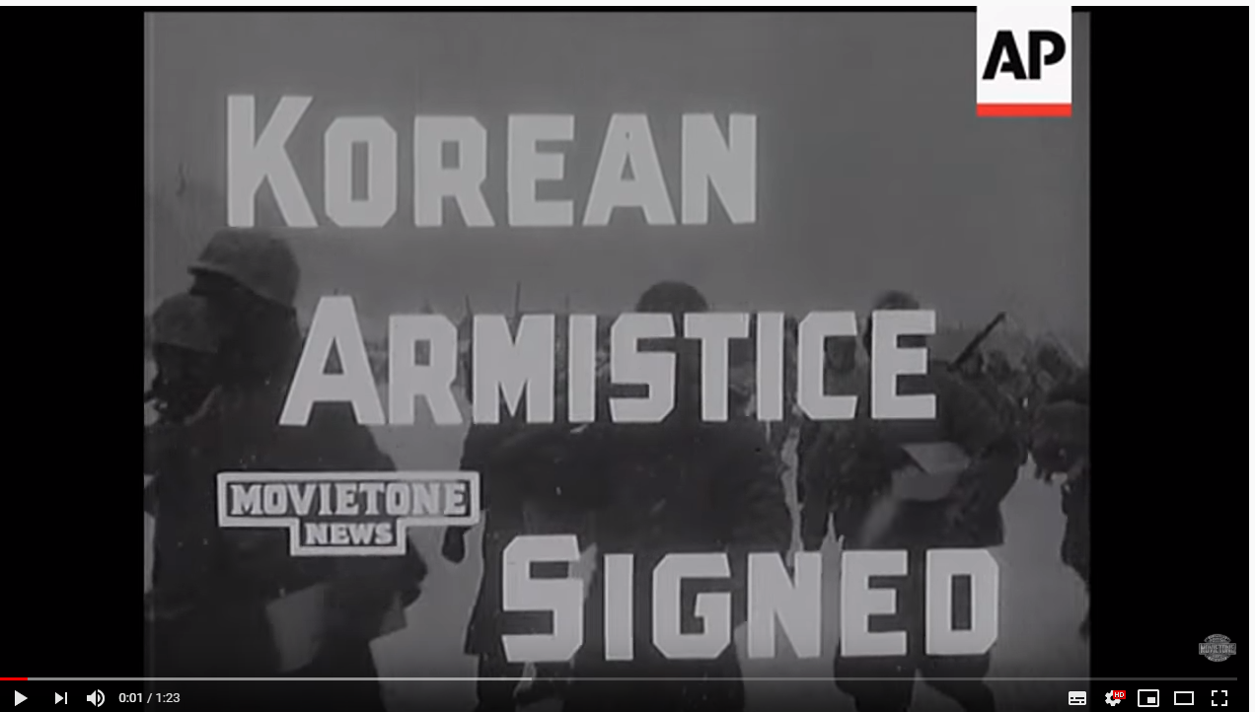
Introduction to the Armistice
Notes:
Video: www.youtube.com/watch?v=HuSyYJsJZD8

Slide 13
Why did the war drag on for two more years after 1951?
​ | Content​ Its view on why there was a delay to the Armistice​ | Provenance​ Nature, origin and purpose of the source (if relevant)​ | Tone and emphasis Does this affect the utility of the source? | Usefulness​ ... for understanding why the Armistice was delayed ​
1​ | ​ | ​ | ​ | ​
2​ | ​ | ​ | ​ | ​
3​ | ​ | ​ | ​ | ​
4​ | ​ | ​ | ​ | ​
5​ | ​ | ​ | ​ | ​
6​ | ​ | ​ | ​ | ​
7​ | ​ | ​ | ​ | ​
Activity 3
Complete this table using Sources 1–7 on slides 14–20

Slide 14

Source 1:
The POW question
EVIDENCE PACK
https://koreanwarlegacy.org/chapters/a-barrier-to-armistice-what-to-do-about-prisoners-of-war
Use the text information and oral accounts of the soldier and airman for personal accounts as to why the POW question contributed to prolonging the war.
Notes:
Videos: https://koreanwarlegacy.org/chapters/a-barrier-to-armistice-what-to-do-about-prisoners-of-war

Slide 15
EVIDENCE PACK
Source 2:
Eisenhower: ‘I shall go to Korea’ speech, 24 October 1952
‘I shall go to Korea... Carefully, then, this new administration, unfettered by past decisions and inherited mistakes, can review every factor – military, political and psychological – to be mobilized in speeding a just peace…
We can shape our psychological warfare program into a weapon capable of cracking the Communist front.
… The vital lesson is this: to vacillate, to appease, to placate is only to invite war – vaster war – bloodier war… A foreign policy is the face and voice of a whole people. In rendering their verdict, the people must judge with courage and wisdom. For at this date – any faltering in America’s leadership is a capital offence against freedom… I do not believe it a presumption for me to call the effort of all who enlisted with me – a crusade.’
Notes:
www.eisenhowerlibrary.gov/sites/default/files/research/online-documents/korean-war/i-shall-go-to-korea-1952-10-24.pdf

Slide 16
EVIDENCE PACK
Source 3:
Syngmam Rhee opposing any deal that left Korea divided,
6 June 1953
The new UN proposal is unacceptable to this Government. Therefore, as a counter-proposal, we suggest a simultaneous withdrawal of both the Communist and the United Nations forces from Korea, on the condition that a Mutual Defense Pact be concluded between the Republic of Korea and the United States in advance of its carrying out. The Mutual Defense Pact shall include the following three points:
The United States’ participation on the ROK side will be automatic and instantaneous, in case of the Korean peninsula being attacked by any nation or nations.
Adequate supplies of arms, ammunition and general logistic materials will be given Korea for the purpose of making Korea strong enough to defend itself so as to safely release every American citizen from action in Korea.
The United States Air and Naval forces will remain where they are now, pending the build up of their Korean counterparts to an adequate degree, so as to deter the enemy from attempting another aggression.’
Notes:
https://digitalarchive.wilsoncenter.org/document/119372.pdf?v=2fbcfc6ba3f9a675eabbdae9bbae308d

Slide 17
Source 4:
US views of Rhee: NSC meeting, 18 June 1953
EVIDENCE PACK
‘Eisenhower displayed anger, frustration, and anxiety, which even the moderating pen of the official notetaker cannot diminish. The president asserted that in certain circumstances the United States might have no option but to withdraw from Korea. Cutler asked if Eisenhower meant “that the whole Korean venture was over and we are getting out”.’
[At this point, according to the record of the meeting] ‘Secretary Dulles asked to be heard, and stated his belief that the disaster was not irreparable if from now on it were correctly handled. It seemed plain… that President Rhee was engaged in a last desperate effort to torpedo the armistice and to force the hand of the United States. If he realizes that his attempt won’t work, Rhee may well feel compelled to give up. It will then be our task to find out whether the Communists really want an armistice so badly that they will be willing to overlook the release of 25,000 of the North Korean prisoners... It was Dulles’ guess, however, that they were so anxious for an armistice that they would overlook what happened. Nevertheless, we must take the strongest possible line with Rhee so that he will not imagine that he can actually run the show.’

Slide 18
Source 5:
View of Stalin regarding the negotiations,1952
EVIDENCE PACK
Soviet, Chinese and North Korean officials discuss the military situation in Korea and the status of armistice talks. Record of conversation 4 September 1952
Kim Il Sung: In my opinion, we have no differences of principle. We agreed with those alternatives which the Chinese comrades proposed but in view of the serious situation in which the Korean people have found themselves we are interested in the quickest possible conclusion of an armistice [peremirie]. The Chinese comrades are also interested in this.
Stalin: We have discussed this issue with the Chinese delegation here. A proposal was made not to agree to the conditions about POWs offered by the Americans and to insist on our own. The opinion was expressed that if the Americans do not wish to return 20% of the Chinese and Korean POWs then 10% of the Americans ought to be held until the Chinese and Korean POWs are returned, or to say that if they do not return these 20% of Chinese and Korean POWs then 20% of their POWs will not be returned as long as they hold the Chinese and Korean POWs.
It is possible that this position is even better. One could stop with this and reach a cease-fire. Continue the talks about the unreturned part of POWs after a halt in combat operations, after a cease-fire.
Notes:
4 September 1952 record of a conversation between Stalin, Kim Il Sung, Pak Heon-yeong, Zhou Enlai and Peng Dehuai
https://digitalarchive.wilsoncenter.org/collection/169/korean-war-armistice/4

Slide 19
Source 6:
Kim Il Sung: Time to end the war, 1953
EVIDENCE PACK
Report that Kim Il Sung agrees that it is time to bring the war to an end, if not through military means then through negotiations, 29 March 1953
‘Kim Il Sung again declared that he fully agrees with the proposal of the Soviet government on the Korean question and considers that this proposal must be implemented as soon as possible.
Kim Il Sung further underscored that the time has come to show initiative from our side on the question of the conclusion of the war in Korea and achievement of peace. It is necessary, Kim said, either actively to carry out military operations or to end the war; a further dragging out of the existing situation is not in the interests of the DPRK and PRC, or of the entire democratic camp. In connection with this, Kim pointed out that the losses on the Korean side at the front and in the rear (daily nearly 300–400 persons) are very significant and it is hardly advisable to conduct further discussion with the Americans regarding repatriation of a disputed number of prisoners of war.
In the present conditions, Kim said, the proposal of the Soviet government is the most advisable and correct.
Kim Il Sung is taking measures to prepare for the anticipated negotiations: the number of sick and wounded prisoners in the DPRK is being determined, materials for the negotiations in Panmunjom are being prepared,
a statement from Pyongyang is being prepared, etc.’
Notes:
https://digitalarchive.wilsoncenter.org/collection/169/korean-war-armistice/4

Slide 20
Source 7:
Telegram from Kuznetsov after meeting with Mao, July 1953
EVIDENCE PACK
Telegram from Kuznetsov to MID regarding his meeting with Mao on 28 July 1953, during which Mao talked about the steps that had led to and now had to be taken following the signing of the armistice, 29 July 1953
‘Among the political causes that forced the enemy to conclude an armistice, Mao noted the military contradictions in the camp of the imperialists and the significant activation of world social opinion, which is speaking out against the war in Korea.
Concerning economic causes, Mao stated that in the first two years of the war the American monopolists amassed colossal profits in military orders and deliveries, but with the end of the negotiations for an armistice, and also as a result of the strengthening of the movement to end the war in Korea, their profits began to fall sharply.
Having returned to the military side of the matter, Mao noted that from a purely military point of view it would not be bad to continue to strike the Americans for approximately another year in order to occupy more favorable borders along the Changan river. Further movement to the south would risk stretching out the flanks in the west and east shore of Korea. In this case the danger of landings in the rear of the Chinese-Korean troops would grow significantly.’
Notes:
https://digitalarchive.wilsoncenter.org/collection/169/korean-war-armistice/4

Slide 21
Plenary
Lesson 7.1
Why did the Korean War drag on until 1953?
Overall, what do you think was the main factor that contributed towards prolonging the war until 1953?
Why do you think there was no peace treaty?

