Slide 1
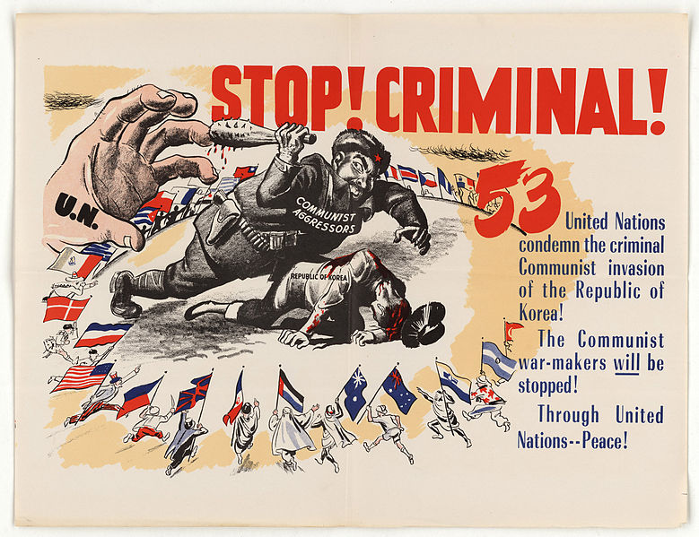
Enquiry 4:
The UNO intervention Why did the UNO join the USA in the Korean War?
Notes:
Image: U.S. National Archives and Records Administration, https://commons.wikimedia.org/wiki/File:Stop_Criminal!_-_NARA_-_5730086.jpg

Slide 2
Enquiry overview:
The UNO intervention Why did the UNO join the USA in the Korean War?
Enquiry 4:
Lesson 4.1
Why did the UNO join the USA in the Korean War?
Lesson 4.2
Case studies:
How significant a role did members of the UN play in the Korean War?

Slide 3
Lesson 4.1 Overview
Lesson 4.1
Why did the UNO join the USA in the Korean War?
Content covered in the lesson:
Why did the UN pass Resolution 83?
Who was in the multi-national force?
What was the role of Marshall Aid?
Review: Why did the UN join the USA in the Korean War?

Slide 4
Stop! Criminal!
Starter:
Look at Source 1.
What is the message of this source? Highlight a keyword and image that helps you to answer this question and be ready to share your answer.
Come up with a possible answer to the enquiry question: Why did the UNO join the USA in the Korean War?
Source 1: An American poster produced during the Korean War. The number ‘53’ refers to the number of countries in the UNO that condemned Chinese intervention in Korea.
Notes:
Image: U.S. National Archives and Records Administration, https://commons.wikimedia.org/wiki/File:Stop_Criminal!_-_NARA_-_5730086.jpg

Slide 5

1. Why did the UN pass Resolution 83?
What was the United Nations Organisation?
Established in 1945 to promote international co-operation and peacekeeping.
Initially, the UN had 51 member states.
Major decisions (called Resolutions) were voted on by the Security Council.
In 1950, the Security Council consisted of five permanent members:
  The Republic of China
  France
  The USSR
  The UK
  The USA
Notes:
Image: Public domain/United Nations: https://commons.wikimedia.org/wiki/File:Flag_of_the_United_Nations.svg

Slide 6
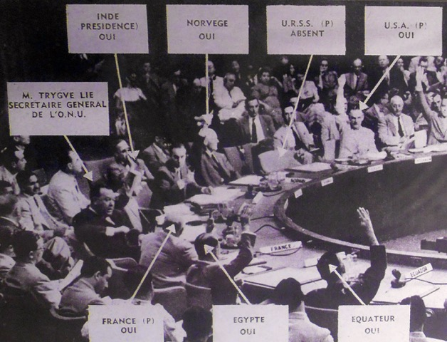
Why did the UN pass Resolution 83?
In June 1950, the United Nations adopted Resolution 83, stating that its members should provide military assistance to South Korea in its fight against the communist North.
A Resolution is the formal name given to a decision made by the United Nations.
Source 2:
This photo shows this meeting in 1950.
Can you see whose chair is empty?
Notes:
Image: Credit unknown, https://nedforney.com/index.php/2018/07/03/united-nations-resolution-korean-war/

Slide 7
Why did the UN pass Resolution 83?
Source 3:
The UN Security Council votes to intervene in the Korean War
‘At the State Department’s urgent request, a special session of the UN Security Council was called by the Secretary General Trygve Lie for Sunday afternoon. The Soviet Union had walked out of the Security Council in January [1950] to protest the UN decision not to admit Communist China, and it was still boycotting the Council in June.
Under these extraordinary circumstances, the Security Council unanimously condemned North Korea’s aggression and called for withdrawal to the 38th Parallel. Two days later, on 27 June, the UN went even further by calling on all member states to extend military aid to South Korea.
With the Soviets absent from the Security Council, the UN voted for the first time to send a military force to assist one country attacked by another.’
From Isaacs, J. and Downing, T. (1998) Cold War, Bantam Press, pp. 100–101

Slide 8
Why did the UN pass Resolution 83?
Activity 1
On your own copy of Source 3, highlight the causes that resulted in the United Nations’ decision to intervene in Korea.
Copy the line below into your book. Write a summary of each cause on the line, showing how important you think each cause was. An example has been done for you.
The Security Council condemned North Korea’s aggression
Not important
Causes that led to UN intervention in Korea
Vital

Slide 9
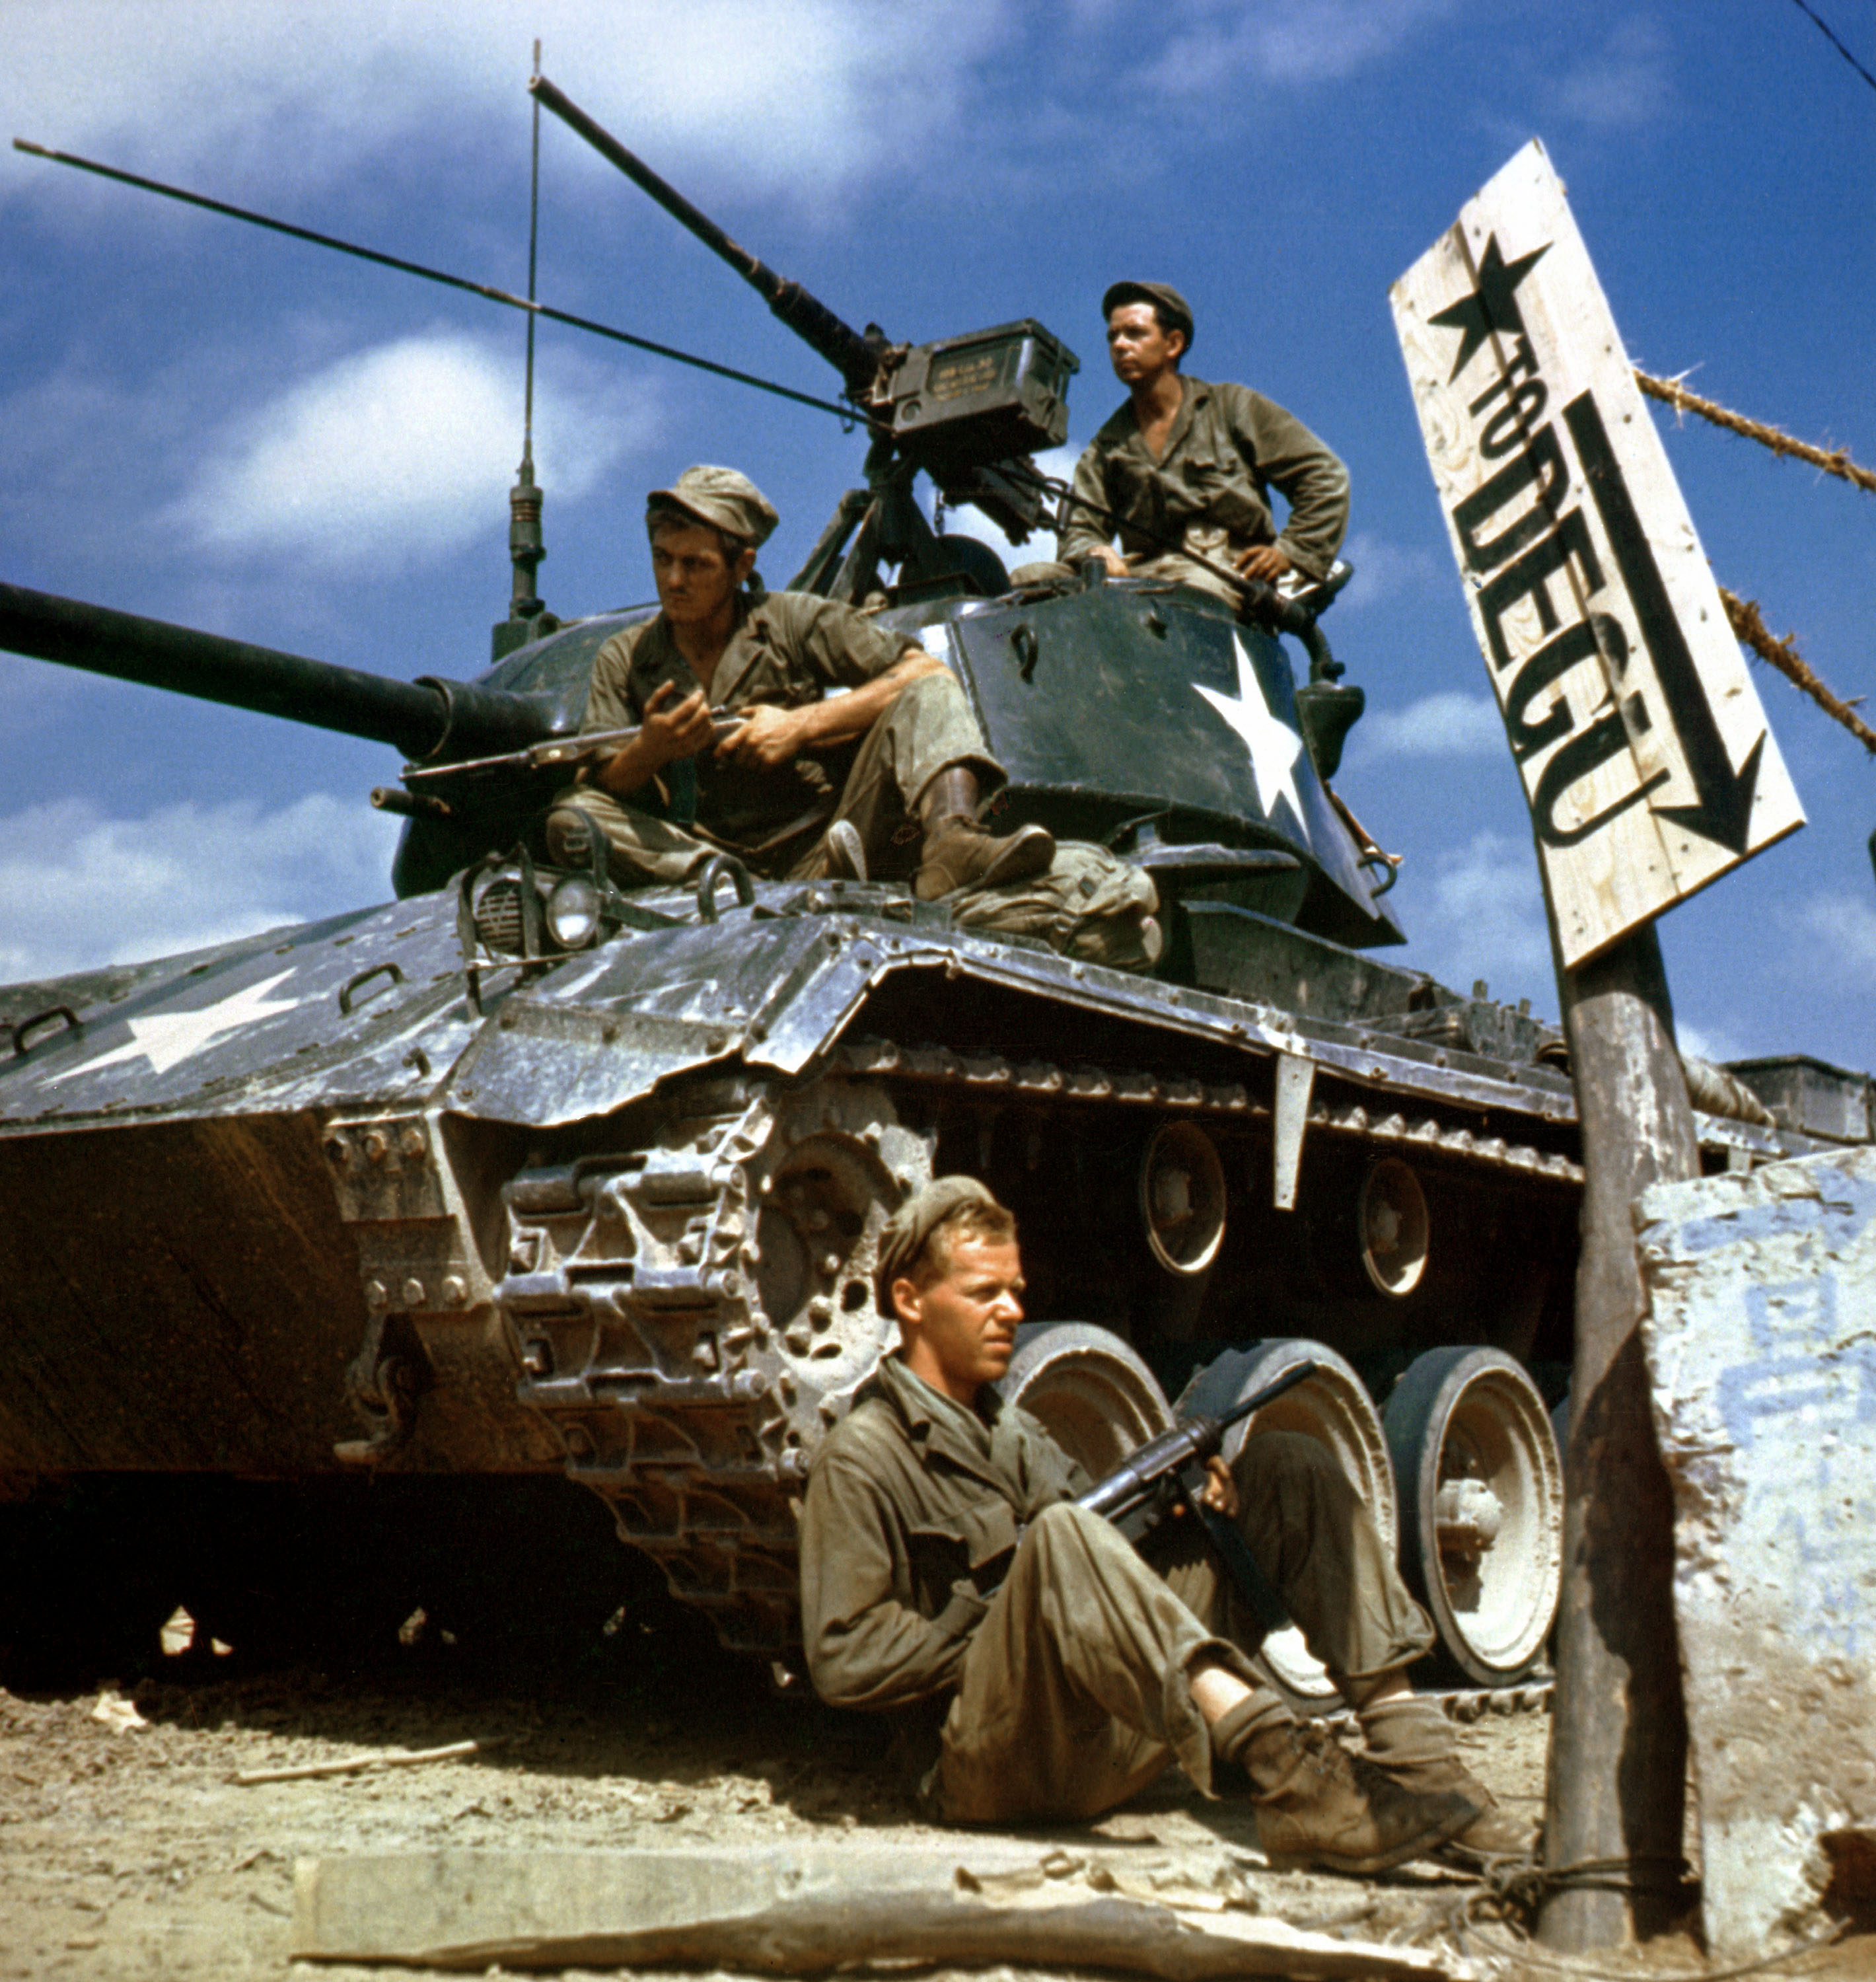
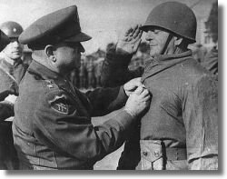
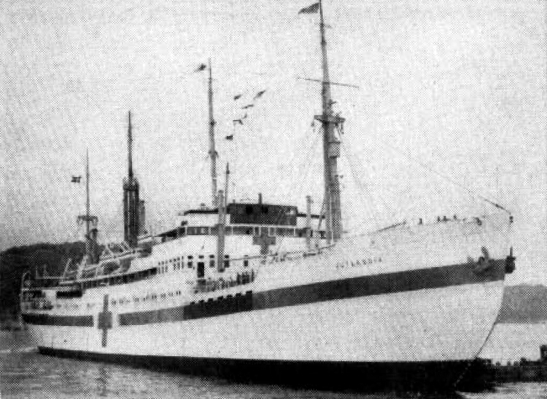
2. Who was in the multi-national UN force?
Led by the United States, 21 countries of the United Nations took part in the Korean War, including:
USA
Turkey
Denmark
Notes:
Left: US Army, https://commons.wikimedia.org/wiki/File:WaltonWalker%26TahsinYazici.jpg
Centre: US Navy, https://commons.wikimedia.org/wiki/File:Danish_hospital_ship_Jutlandia_in_Korea_1951.jpg
Right: US Army, https://commons.wikimedia.org/wiki/File:HA-SC-98-06983-Crew_of_M24_along_Naktong_River_front-Korean_war-17_Aug_1950.JPEG

Slide 10
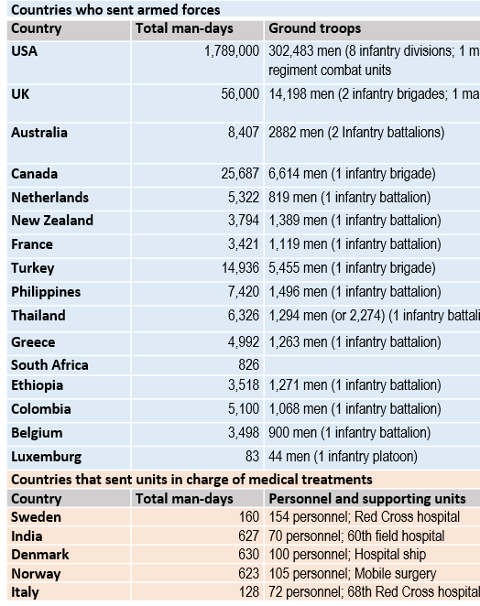
Who was in the multi-national UN force?
Activity 2
The table on the right (Source 4) shows which UN members joined the UN force in the Korean War.
1. On your own copy of this table, highlight which country:
Contributed the most man-days.
Contributed an aircraft carrier plus over 50,000 man-days.
Contributed a hospital ship.
Provided the third-largest contribution in man-days.
Was situated closest to the Middle-East and also contributed soldiers.
Provided 819 men.
2. (Extension):
Which members of the Security Council did not contribute to the UN force? Why do you think this was?

Slide 11
Who was in the multi-national UN force? Answers
Contributed the most man-hours. The USA
Contributed an aircraft carrier plus over 50,000 man-hours. The UK
Contributed a hospital ship. Denmark
Provided the third-largest contribution in man-hours. Canada
Was situated closest to the Middle-East and also contributed soldiers. Turkey
Provided 819 men. The Netherlands
Extension:
China had emerged as a communist country after a large civil war. However, its seat on the UN was held by its previous, non-communist government
(in Taiwan), which was now effectively powerless.
The USSR had boycotted the UN in 1950 in protest over China’s seat not being given to China’s communist government. The USSR was also a communist country and offered its support to North Korea.

Slide 12
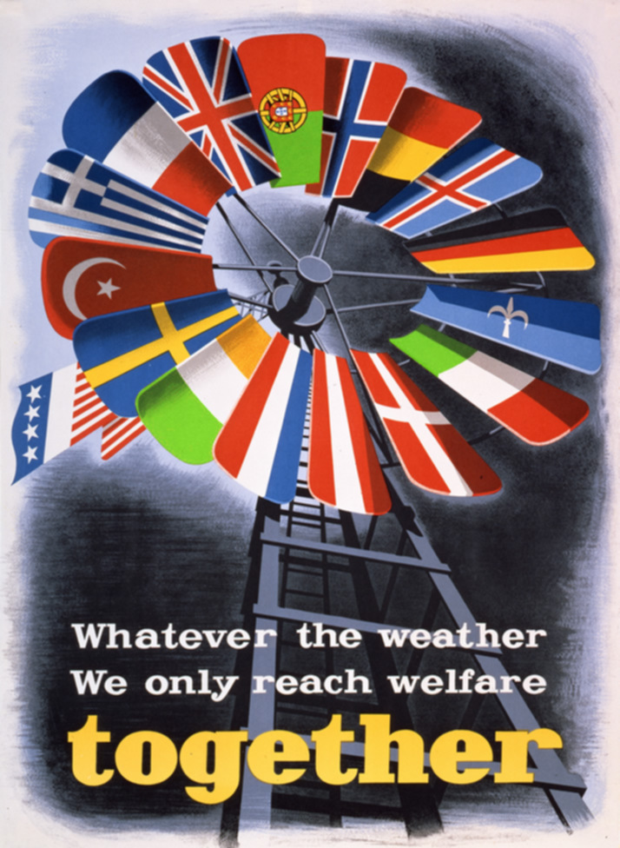
3. What was the role of Marshall Aid?
Marshall Aid was financial aid given by the USA to countries in Europe after 1948.
This money was to support the development of their economies and infrastructure as they recovered from the effects of the Second World War.
In total, the USA provided $15 billion in financial assistance to recipients of Marshall Aid.
Notes:
Image: Courtesy of the George C. Marshall Foundation, Lexington, Virginia https://www.marshallfoundation.org/library/posters/whatever-weather-reach-welfare-together/

Slide 13
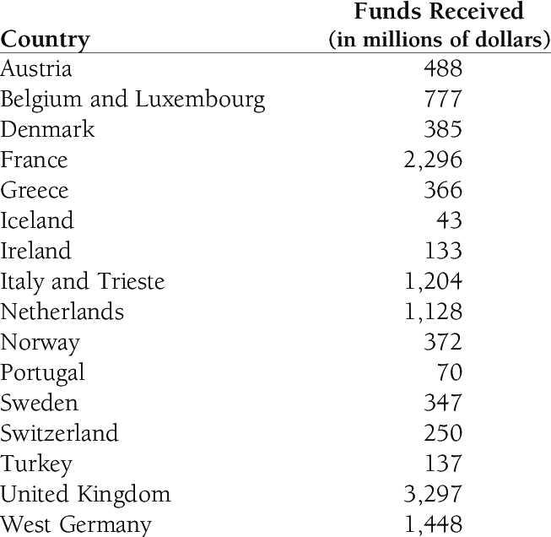
What was the role of Marshall Aid?
Activity 3
The table on the right (Source 5) shows how much money each recipient of Marshall Aid received from the USA.
On your own copy, find and highlight the countries that you identified in the previous task.
Can you see any link between the money that these countries received and their contribution to the UN force in the Korean War? If so, why do you think this is? Discuss your ideas with a partner.

Slide 14
Why did the UN join the USA in the Korean War?
Plenary
Review your initial ideas about the enquiry question from the start of this lesson.
What reasons can you now add to show why the UN intervened in Korea?
Think about:
The members of the Security Council
The amount of support given by each country
The USSR’s boycott of the Security Council
The influence of the USA

