Slide 1
Various Types of Memorials

Slide 2
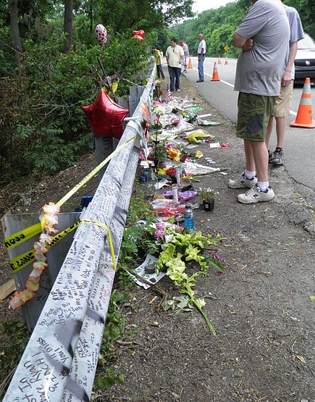
Spontaneous Memorials
You often see them on roadsides following accidents or following 9/11 on the fence of Trinity Church. Spontaneous memorials tend to be fleeting but powerful representations of our emotional and psychological reactions to life.
Not planned or thought out.

Slide 3
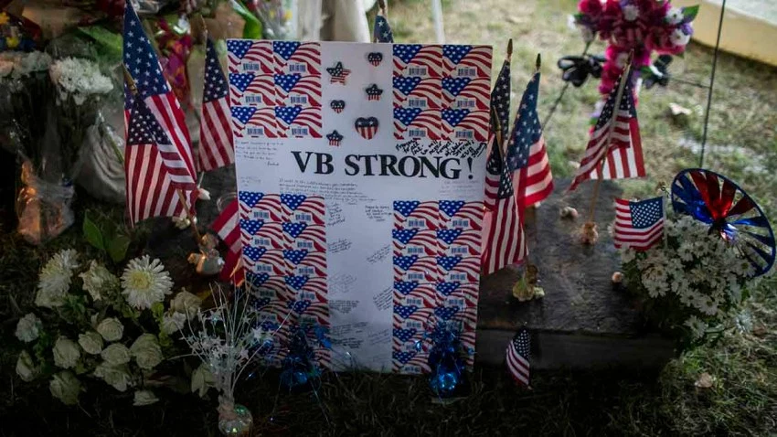
A portion of the memorial to the victims of the mass shooting in Virginia Beach, May 31, 2019

Slide 4
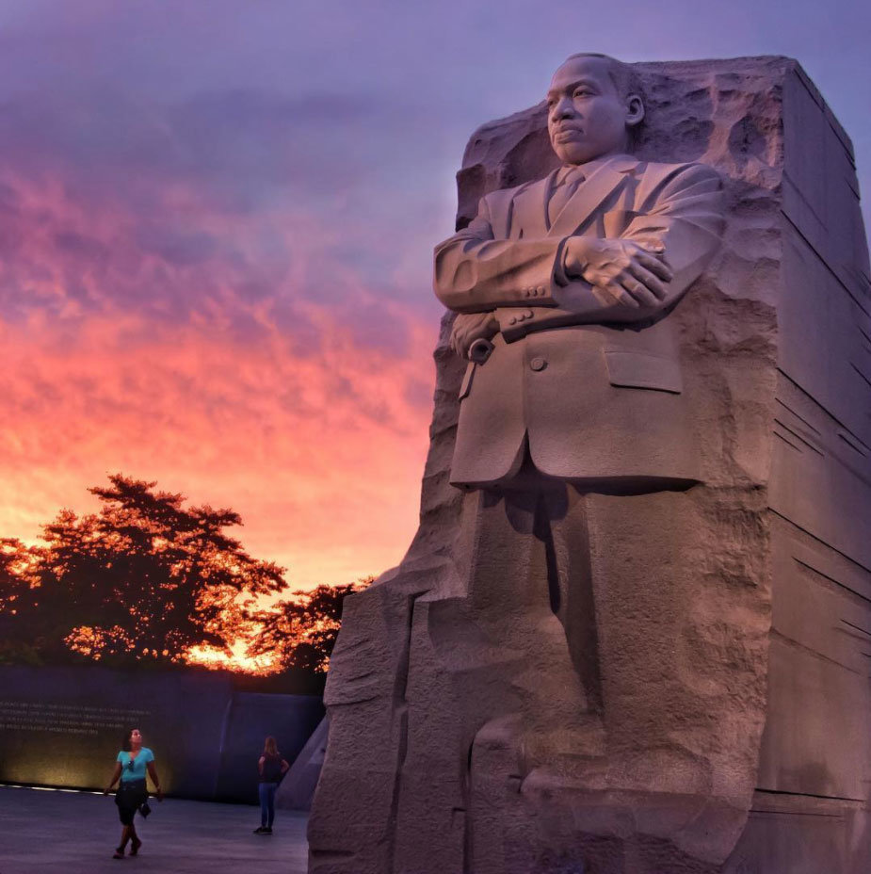
Traditional Memorials
Something, especially a structure, established to remind people of a person or event
Memorial planned, thought out, and funds raised

Slide 5
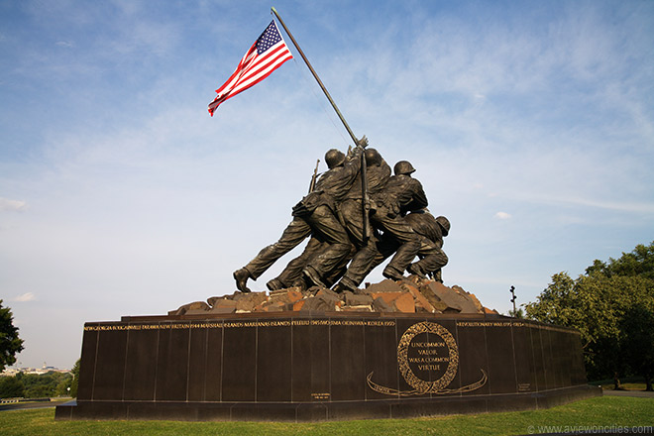
U.S. Marine Corps Memorial
Raising the flag at Mt Suribachi, Iwo Jima, 1945
Memorial located in Arlington, VA

Slide 6
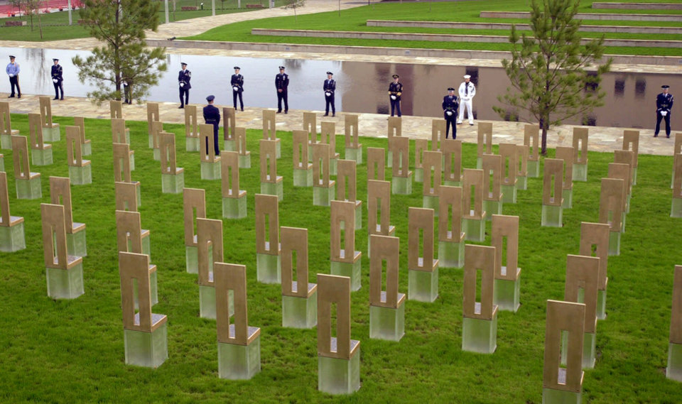
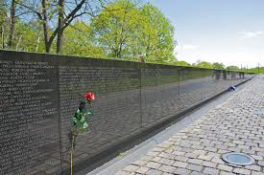
Memorials in Conflict
Different perceptions/memories trying to control the view of history
TOP: Oklahoma City Memorial
BOTTOM: Vietnam War Memorial

Slide 7
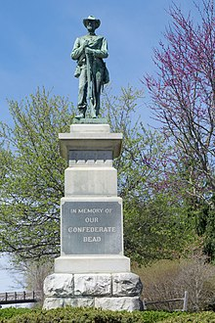
American Civil War
Monuments across the south; many outside of court houses
Memorialization of the Perpetrators or the Victims?
Argument is one of honoring the Southern dead vs reminding people of color of their previous status
To remove or not?

Slide 8
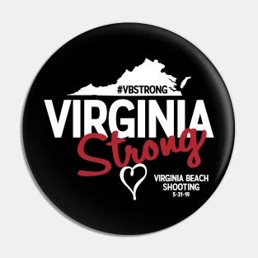
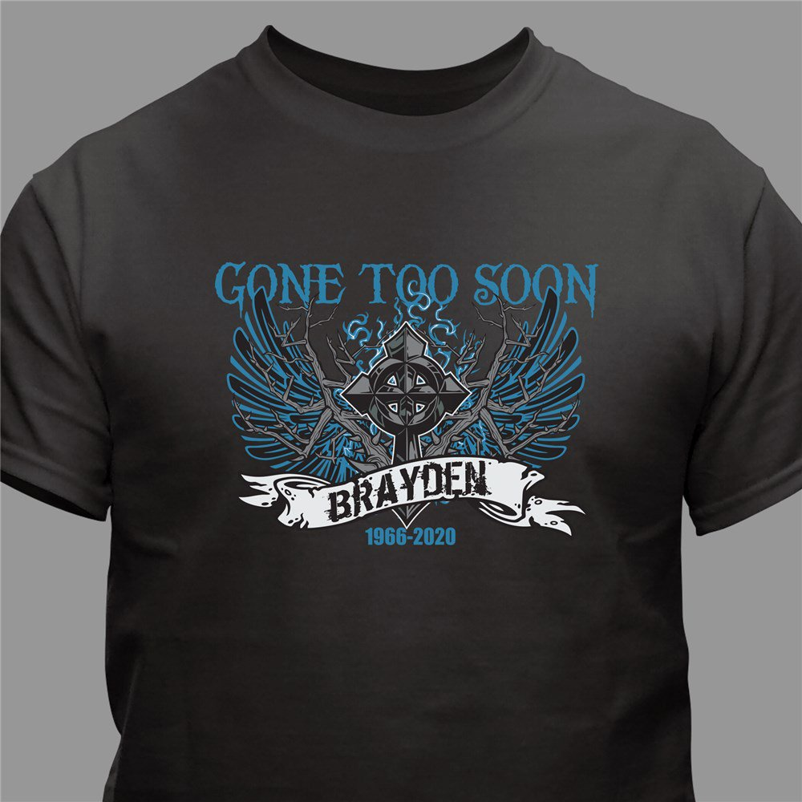
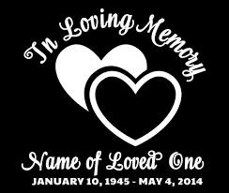
Personal Memorials
T-shirts/buttons honoring lost friends or loved ones

Slide 9
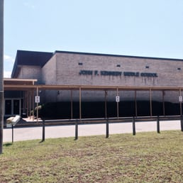
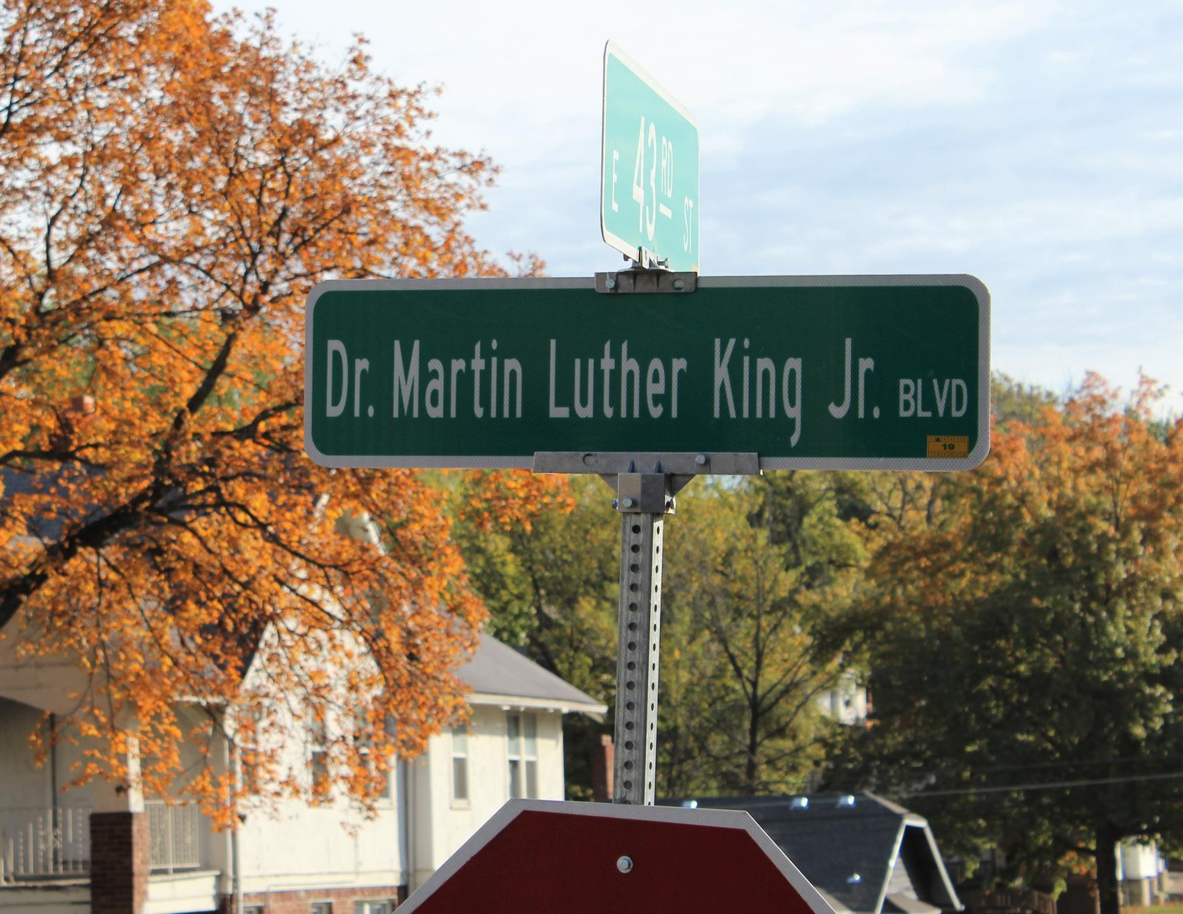
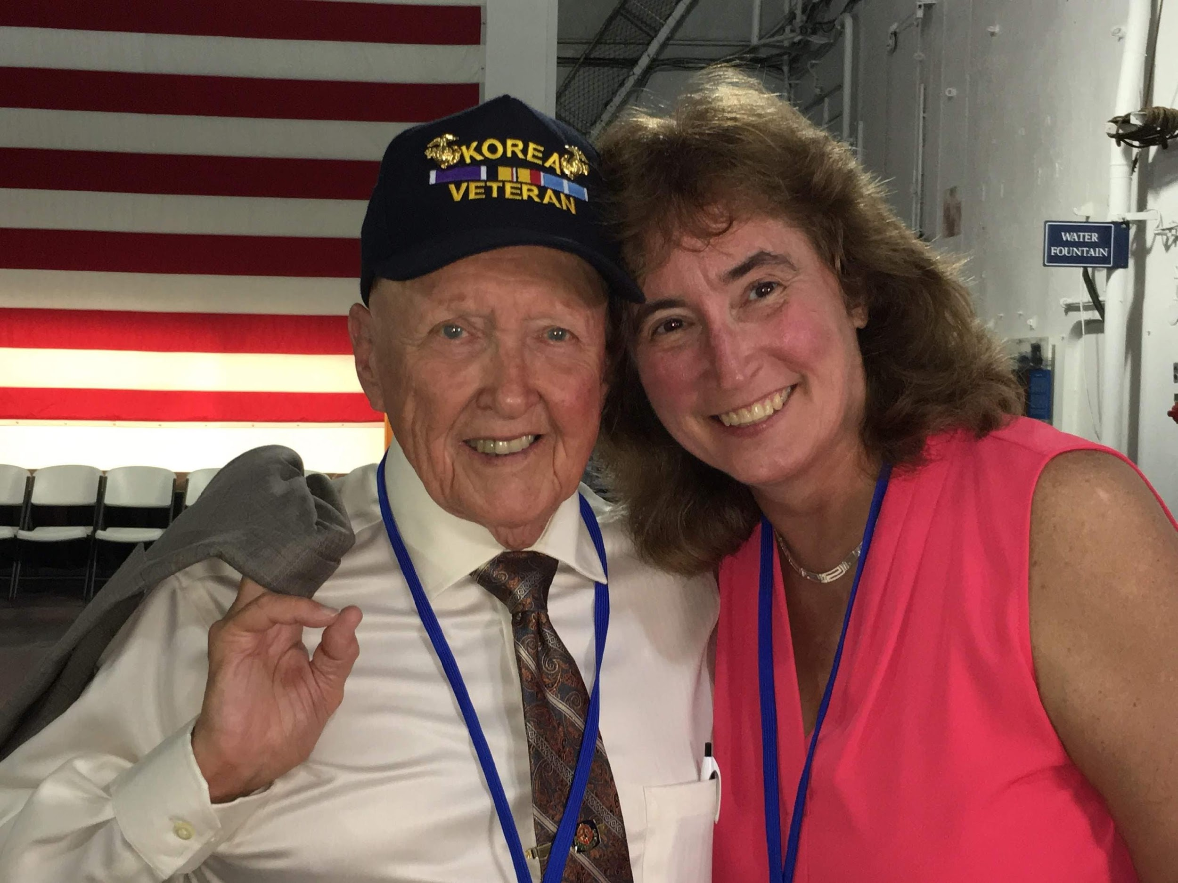
“Other” Memorials
Oral histories, school buildings, street names
https://koreanwarlegacy.org/interviews/wallace-stewart/

Slide 11
The Korean War Memorial
Washington, D.C.

Slide 12
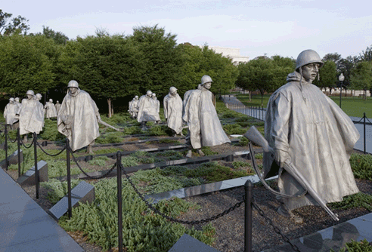
19 stainless steel statues representing Army, Navy,
Air Force, and Marine soldiers as an ethnic cross section of America.

Slide 13
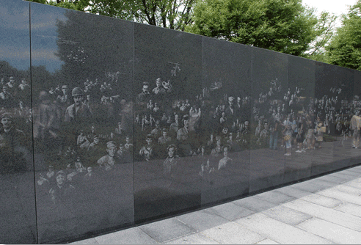
A mural of over 2,400 actual photographs representing those who worked in support of the foot soldiers. The reflections in the granite create an image of 38 statues, representing the 38th parallel.

Slide 14
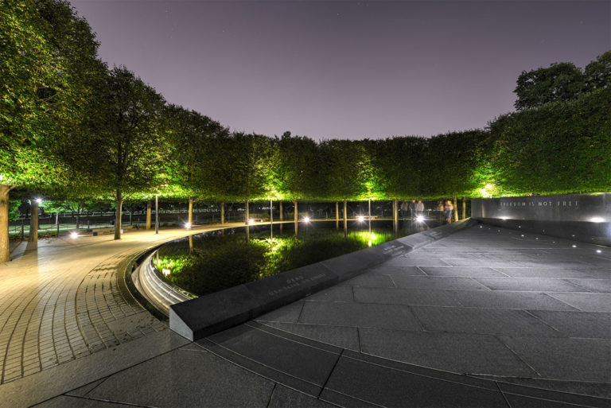
The Pool of Remembrance lists the war in terms of KIA, MIA, WIA, and POW. It includes benches for reflection.

Slide 15
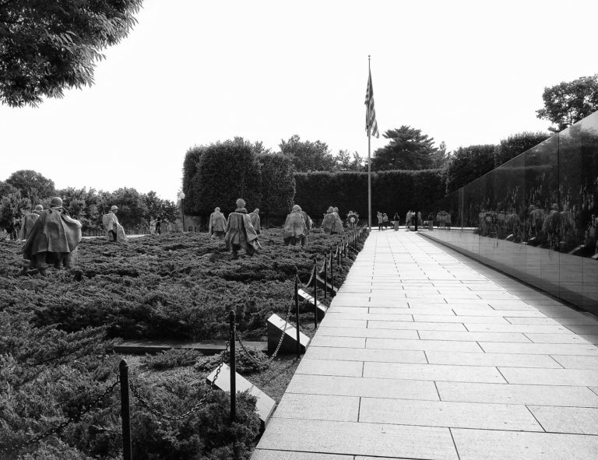
To the left of the mural wall are 22 plaques listing the names of the countries who contributed troops to the United Nations effort

Slide 17
https://koreanwarlegacy.org/interviews/wallace-stewart/ SOU
Sources:
https://www.google.com/imghp?hl=en
http://spontaneousmemorials.tumblr.com/
https://www.koreanwarvetsmemorial.org/the-memorial/
Wallace Stewart photo courtesy of Mary T. McCullagh, June 2018

