Slide 1
History Beyond the Textbook

Slide 2
Student Outcomes & Learning Targets
Students will be able to evaluate and interpret the historical event(s) through multiple perspectives of veterans.
Students will learn about methods used to acquire primary source interviews from people regarding historical events
Students will synthesize evidence from artifacts and primary to obtain information about events in World history.
Students will understand that different veterans may have differing perspectives on the Korean War and those experiences may reflect differently in the way they recognize their participation in the war.

Slide 3
Day 1 (45 min)
Primary Sources and Artifacts

Slide 4
We are not makers of history. We are made by history.
-Martin Luther King Jr.

Slide 5
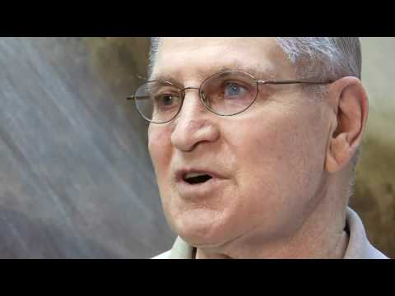
Bruce Ackerman

Slide 6
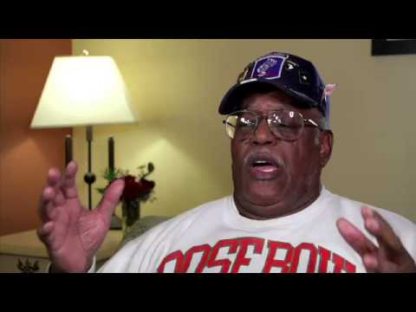
Nathaniel Ford, Jr

Slide 7
Homework
Option 1:
Select 2 veteran interviews from the list below. How did the questions differ in the two interviews? Similarities in questions for both? Did they have artifacts to share? How do the artifacts enhance the interview?
Option 2:
Research 1 veteran from the list below and select an additional veteran interview from the list found at the Korean War Legacy Foundation website. Write down the questions asked of the veterans. What common questions did you notice? What If there were artifacts how did the artifacts enhance the story?
Suggested interviews (w/artifacts):
Jack Allen
James Butcher
John Fischetti
Carl M Jacobsen

Slide 8
Day 2 (45 min)
Homework discussion and formal assessment introduction

Slide 9
Homework Discussion
What did you learn from this assignment?
What similarities were there in the interviews?
What differences did you detect from the interviews?
Are there additional questions that you would have asked had you done this/these interview(s)?
Why would you have included these questions?

Slide 10
Formal Assessment
Oral History Interview

Slide 11
The process is easy
Interview Questions for Veteran
Peer Review
Class Presentation

Slide 12
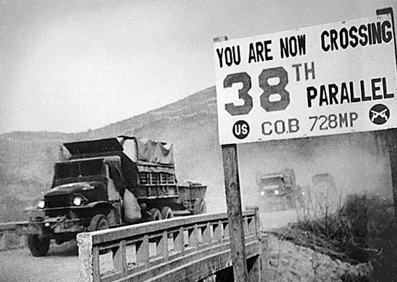

Slide 13
3,000,000
Casualties of the Korean War, majority were civilian

Slide 14
Thanks!
Any questions?
Please do not forget that you can always contact me if you have any questions.

Slide 15
Credits
Special thanks to all the people who made and released these awesome resources for free:
Presentation template by SlidesCarnival
Photographs by Unsplash & Britannica

